Slide 1

Ames House Price Prediction
Will Han
Gary Lin

Slide 2
Table of Content
Background Information
Exploratory Data Analysis (EDA)
Model Tests
Conclusion & Key Take-Aways

Slide 3
Background Information Ames Housing Data
Housing data from Ames, Iowa
79 explanatory variables describing various aspects of residential homes
Results
Goal: predict the sales price for each house in the test set
Metric: root mean squared error (RMSE) between the logarithm of the predicted value and the logarithm of the observed sales price will be used

Slide 4
Exploratory Data Analysis (EDA) Initial Look at the Data & Feature Creation
1460 observations & 79 features (including sale price)
There were many features that had most of the data in one value
There were many features that had quality metrics (i.e. Poor to Excellent)
Ordinal features: used ordinal encoding with zero representing feature is not present (“None”)
Additional features:
Total Sqft; Sqft above ground (2 features)
Total sqft per room, Sqft above ground per room (2features)
Total baths = Full baths + 0.5 * Half baths (1 feature)
Garage QC, ExterQC, BsmtQC, OverallQC (4 features)
QC = Quality Score + Condition Score
Total number of features: 79 = 79 – 9 + 9

Slide 5
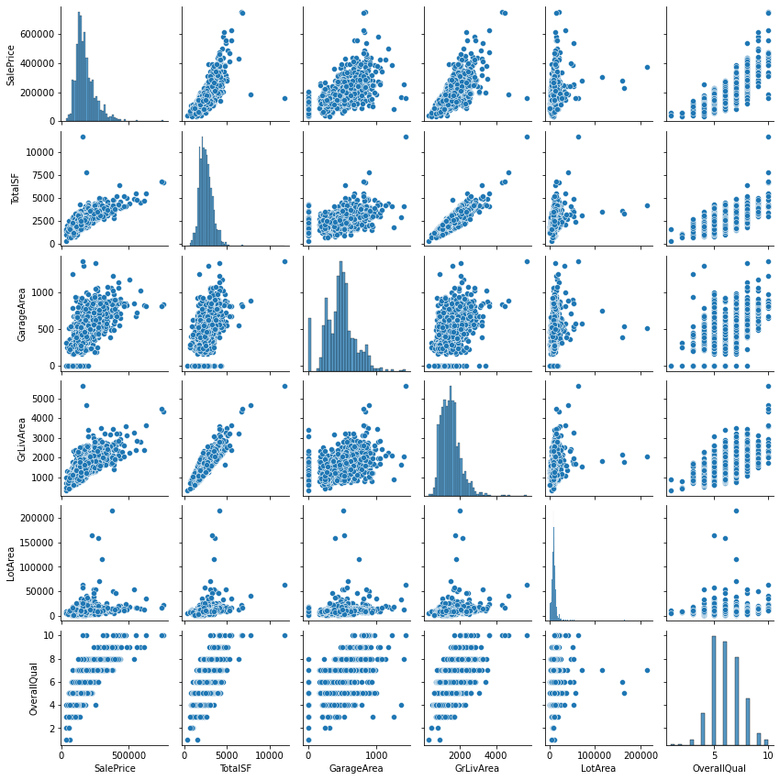
Exploratory Data Analysis (EDA)
Scatter plot of main features:
TotalSF
TotRmsAbvGrd
YearBuilt
LotArea
OverallQual
SalePrice
Removed outliers:
TotalSF > 7,500
LotArea > 10,000

Slide 6
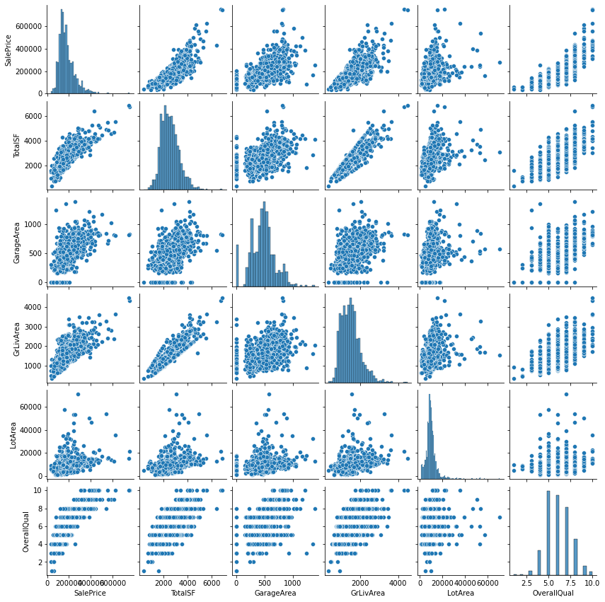
Exploratory Data Analysis (EDA)
Updated scatter plot with outliers removed
Additional checks:
Highly skewed features
Features with no variation

Slide 7
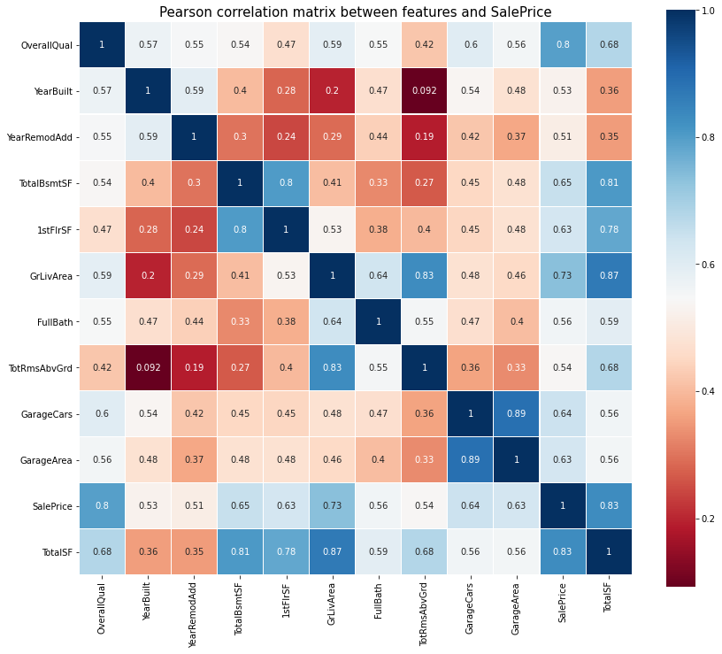
Exploratory Data Analysis (EDA)
Chose features that had a correlation with SalePrice of more than 0.5
All observations seemed very intuitive

Slide 8
Exploratory Data Analysis (EDA) Imputation, Feature Engineering, and Final Cleaning
Imputations:
Imputed missing numerical features using median by neighborhood
Imputed missing categorical features using mode by neighborhood
Feature Engineering:
Used ordinal encoder for ordinal features to capture the relationship between values within the feature
Used target encoding for non-ordinal features
Dropped features where the largest category of the feature encompasses at least 90% of the data
Street, Alley, Utilities, Conditon2, RoofMatl, Heating, Electrical, PoolQC, MiscFeature (9 features)

Slide 9
Model Tests Baseline Model & Goal
Models used:
Random Forest Regression
Gradient Boosting Regression
Light Gradient Boosting Machine (LGBM) Regression
Extreme Gradient Boosting (XGB) Regression
Stacked Meta-Learner
Weighted-Average Meta-Learner (Voting Regressor)
Because dataset is small, 5-fold cross validation was used for all models
Tuning hyperparameters using grid search & Bayesian optimization (hyperopt) for all models
The goal is to find a model that minimizes RMSE of logarithm of sale price

Slide 10
Model Assumptions and Pros and Cons
Random Forest
Advantages: Reduce overfitting, handles categorical & numerical features & nonlinearity, computationally efficient (parallelization)
Disadvantages: does not use information learned from previous models, suffers a lack of interpretability
Gradient Boosting:
Advantages: grow trees using information learned previously, can improve interpretability using smaller trees (e.g., stumps)
Disadvantages: sensitive to overfitting on noisy data, fit trees sequentially
Because sci-kit learn Gradient Boost, XGBoost, LGBM optimize computation of gradients differently, we experiment with all three to test performance

Slide 11
Model Tests Final Dollar Difference & Kaggle Score
Dollar differences, train set RMSE (mean, SD), and test set RMSE, were calculated for each models
XGBoost produced the best test result (minimum RMSE)
Gradient Boosting Regression was the most precise (in terms of RMSE SD)
Model | MAE ($) | Avg. RMSE (Train) | SD RMSE (Train) | Avg. RMSE (Kaggle)
Stacking_best | 4136.627217 | 0.113271 | 0.005805 | 0.1273
XGBR_best | 46.343718 | 0.114867 | 0.017091 | 0.1263
GBR_best | 1045.011959 | 0.116020 | 0.004776 | 0.1274
VotingRegressor_best | 4496.524691 | 0.116430 | 0.008779 | 0.1270
LGBM_best | 6563.607170 | 0.120209 | 0.006327 | 0.12831
RFR_best | 12137.901254 | 0.138661 | 0.007736 | 0.1493

Slide 12
Summary of Models
XGBoost had the best overall performance
Meta-Learners slightly improved performance on train set but not on test set
Extra Tests:
Linear model (ElasticNet) did not improve performance
Possibly due to highly non-linear relationship between features
Remove Less Important Features
Tested XGBoost with a restricted feature set
RMSE was essentially the same

Slide 13
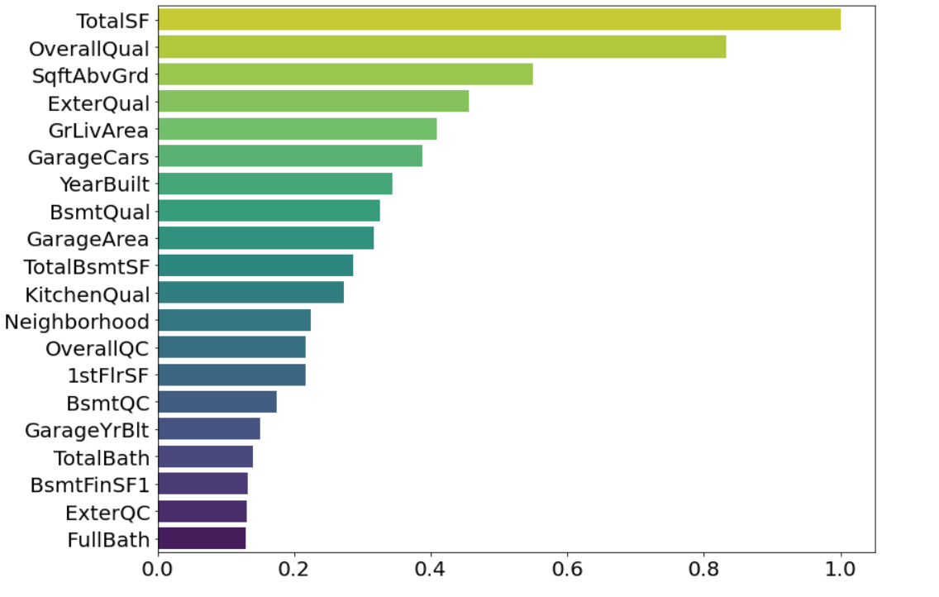
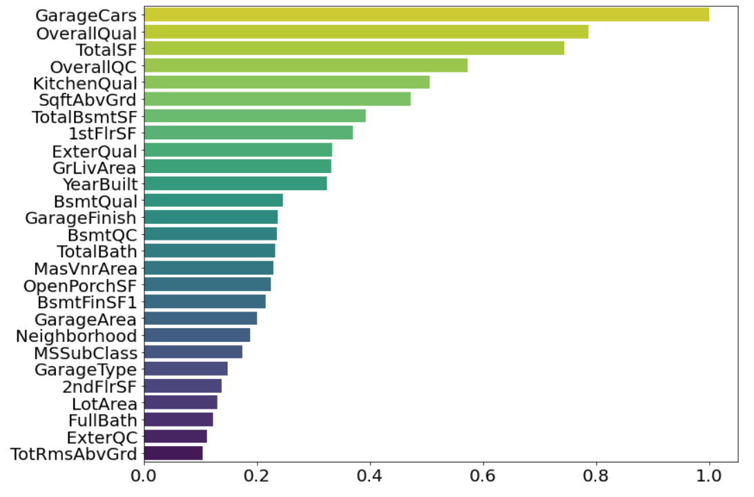
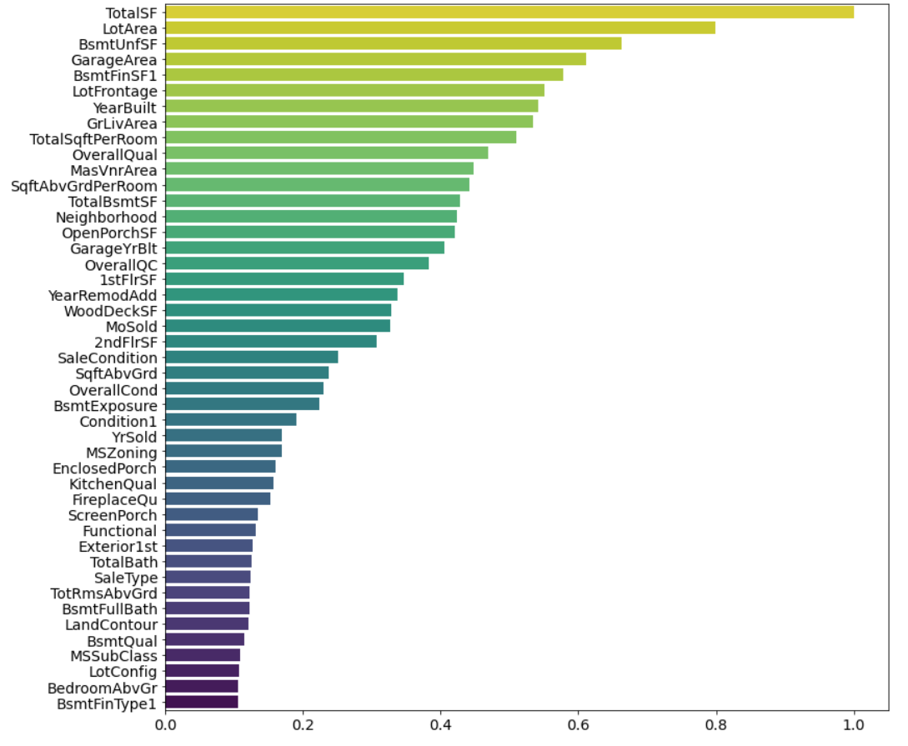
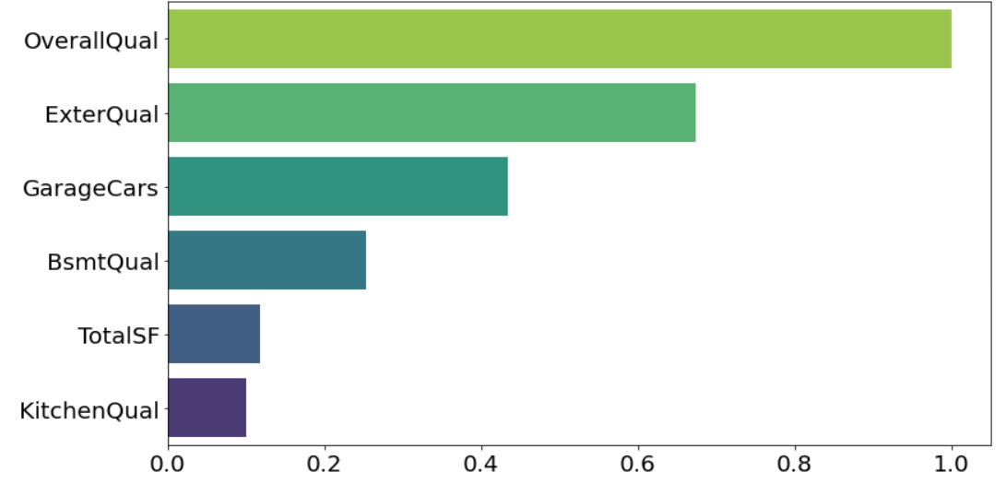
Feature Importance
Features frequently selected by a model to grow trees are important.
Different models select different features (# of features) with different frequencies (% feature importance).
Definition: a feature is important if it is at least 10% of max feature importance in a model
Normalization allows a way to compare feature importance across models.
GBR_best
RFR_best
XGBR_best
LGBM_Best

Slide 14
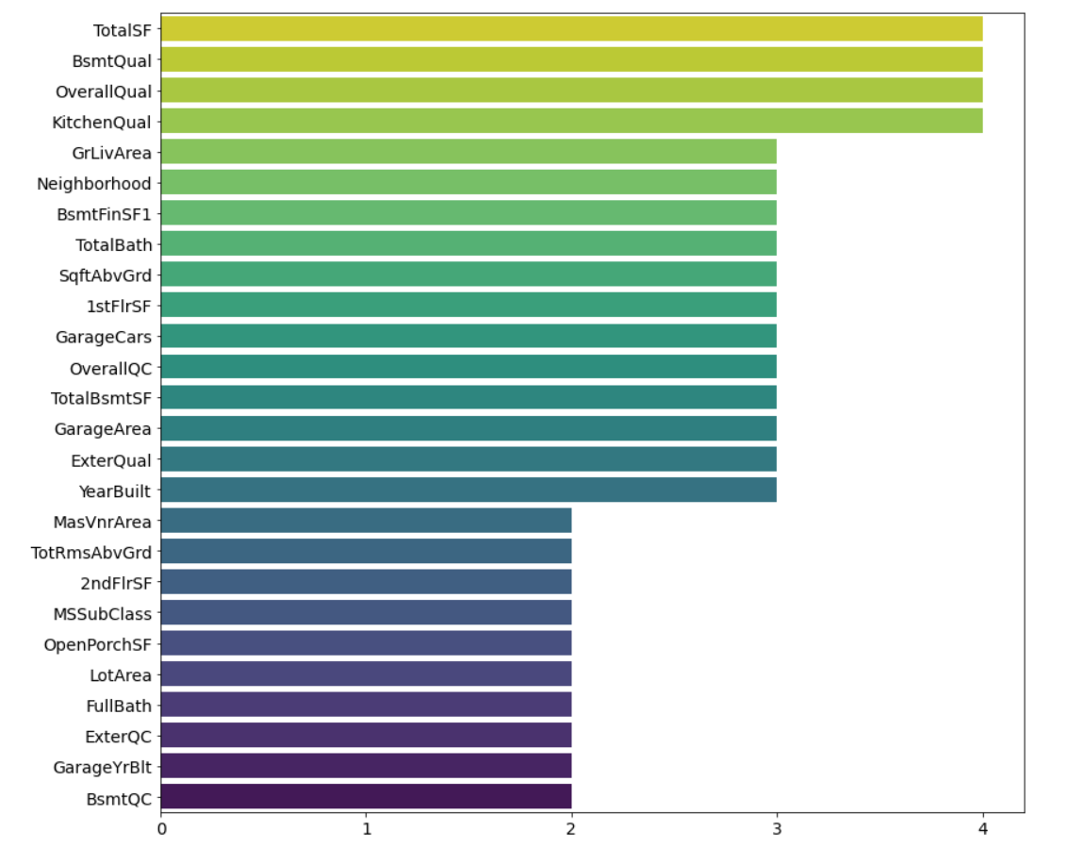
Consistently Important Features
Figure shows features that are at least “important” in two of the models
Most important features are house size and house quality.
Neighborhood, which includes local amenities, is also important.

Slide 15
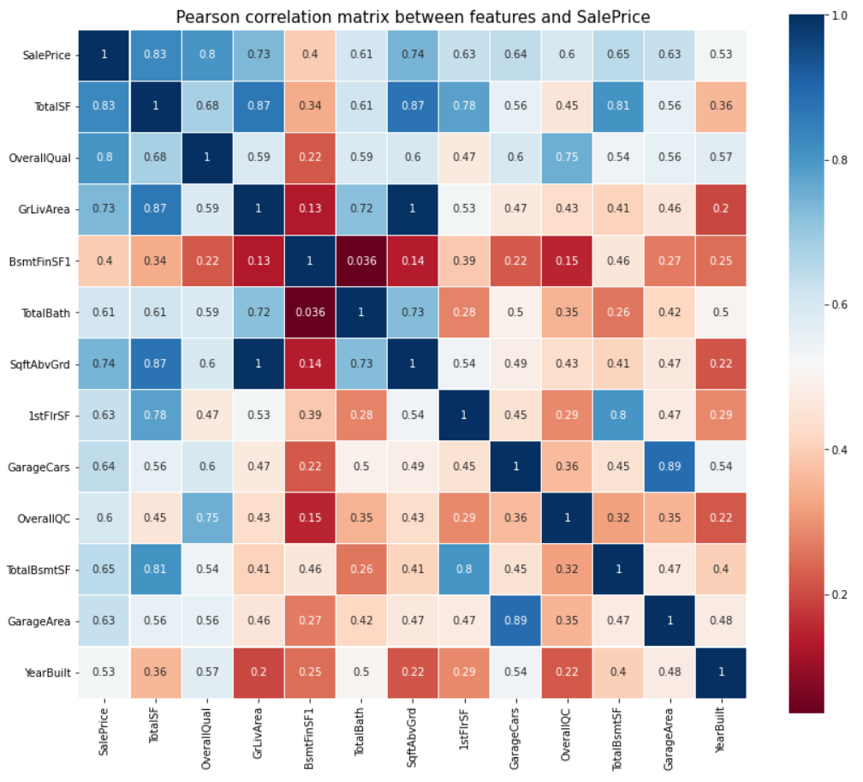
Narrowing down the most important features: features that appear as "important" in at least three models.
Important features are positively correlated with sale price.
Strongest correlation:
Total square footage
Overall quality
Above ground living area
One exception is basement Type 1 finished square footage, which somewhat weakly correlated.

Slide 16
Conclusion & Key Take-Aways
Square Footage and various quality measures (basement, overall, and kitchen) seem to be the most important features based on the four models tested.
Potential uses of the results:
House flippers can use the information to determine where to use their renovation budget on to add the most value to the property
Home owners that are trying to sell their property can focus on increasing basement & kitchen quality before listing to get the most value out of the property

Slide 17
Thank you!

